Slide 1
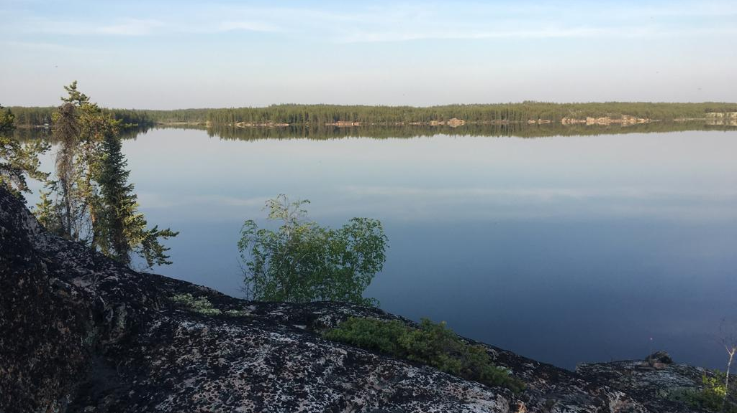

Representation of Spatial Heterogeneity in the MESH Model MWS Capstone Project Presentation August 23, 2019 A project in partnership with Environment and Climate Change Canada

Slide 2

School of Environment and Sustainability
Agenda
Problem Statement
Methods and Results
Site familiarization
Data preparation
Modelling
Findings
Proposed Solution
Representation of Spatial Heterogeneity in the MESH Model
Notes:
I will discuss the goals of the project, methods and results used in each stage, the main findings, and proposed solutions

Slide 3
What were the goals of the project?

Slide 4



Project Goals
White Gull Creek
In the Baker Creek watershed, replicate the MESH modelling methodology used in 2017 in the White Gull Creek watershed
Baker Creek
Take the work further
More grid cells
Different runoff algorithm
?
Evaluate model performance

Slide 5
What is MESH?

Slide 6





M Modélisation E Environmentale communautaire S Surface and H Hydrology
What is MESH?
LSS
Runoff
GEM
Specific Processes
Routing
University of Saskatchewan, 2019 (Haghnegahdar, Tolson, Craig, & Paya, 2015)
Notes:
MESH is Environment and Climate Change Canada’s land surface hydrology model. It is a community system – open-source and continually being developed
MESH is comprised of:
A Land Surface Scheme, which takes care of the vertical water and energy balances
Runoff algorithms
Various representations of other hydrological processes, such as infiltration into frozen soil, groundwater, and baseflow
And routing
One of the benefits of MESH is the ability to do comparative studies by swapping out one land surface scheme for another, or changing the runoff mechanism, such as WATROF and PDMROF
MESH can either be coupled with an atmospheric model such as GEM, or run offline

Slide 7
Site Familiarization

Slide 8
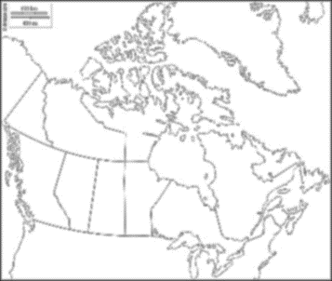
Site Familiarization
Methods
Papers
Photos and maps
Talking to Chris Spence
Results
Climate
Subarctic
Short, cool summers and long, cold winters
Average 289 mm precipitation, 41% snowfall
Geology and Soils
Precambrian Shield (bedrock)
Pockets of glaciolacustrine and weathered bedrock deposits
Overburden thickness ranges from <1m to >10m
Peat and organic matter ranges from thin layer on hillslopes to 1.2 m in peatlands
Yellowknife
Spence & Hedstrom, 2018; Phillips, Spence, & Pomeroy, 2011
Notes:
In order to familiarize myself with the site, I read publications, looked at photos and maps, and talked to Chris, who has done extensive research in the basin
Baker Creek is located in the Northwest Territories, just north of the capital city of Yellowknife and near Great Slave Lake. The climate is characterized as subarctic, with short, cool summers and long, cold winters. The basin receives about 290 mm of rain, on average, 41% of which is snowfall.
The basin is located in the Precambrian shield, and overburden thickness can be 10m thick or more. A layer of peat covers all deposits, with thicknesses ranging from 20cm to over a meter.

Slide 9
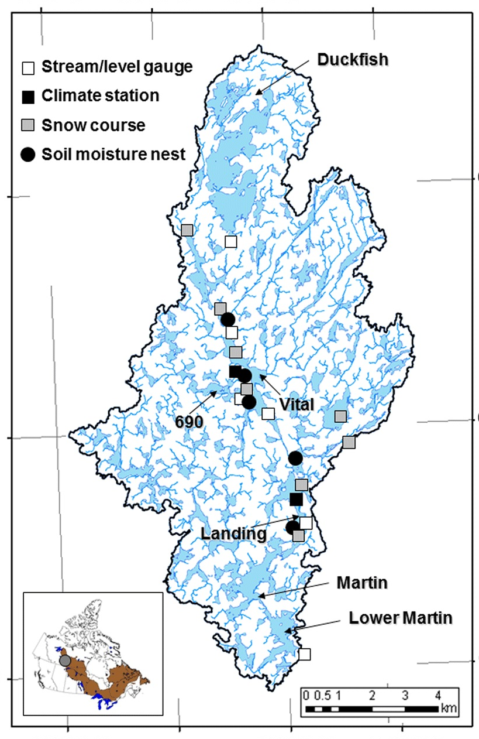
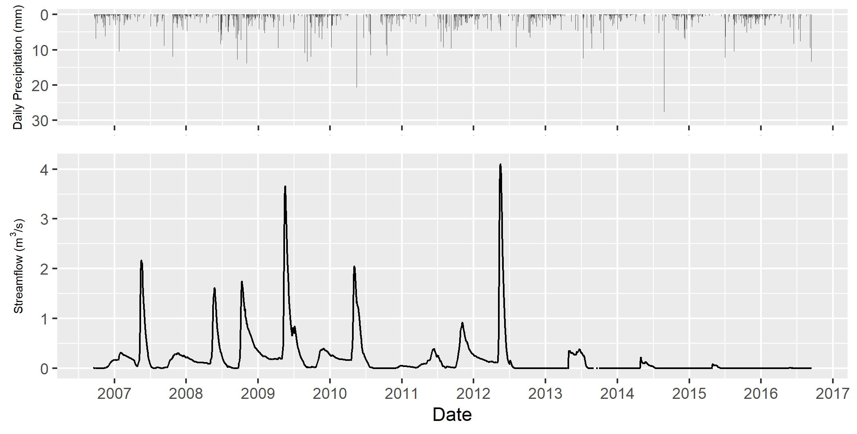
Site Familiarization
Hydrology
349 Lakes; Large lakes dominant
Flow regime is highly variable due to variable storage and release
Soil storage
Infiltration capacity
Bedrock fractures
Rainfall intensity
Evaporation
Discontinuous permafrost
Backflow
Contributing area and “gatekeepers”
Spring snowmelt runoff peaks, smaller fall peaks
Wet period: 2008-2012; Dry period: 2012-2016
WSC Gauge
Spence & Hedstrom, 2018; Phillips, Spence, & Pomeroy, 2011; Spence, 2006
Notes:
The hydrology of the basin is dominated by large lakes connected by short streams. The outlet, defined by a water survey of Canada gauge at the outlet of lower martin lake, experiences a highly variable flow regime due to variable storage and release in the basin. The large lakes and other elements act as “gatekeepers” and the contributing area is highly variable. The annual hydrograph shows spring snowmelt runoff peaks, and smaller fall peaks. However, streamflow is a very small portion of the total rainfall, with runoff ratios of 0.17. During the modelled period, there was a wetter-than-normal period, followed by drier-than-normal.

Slide 10
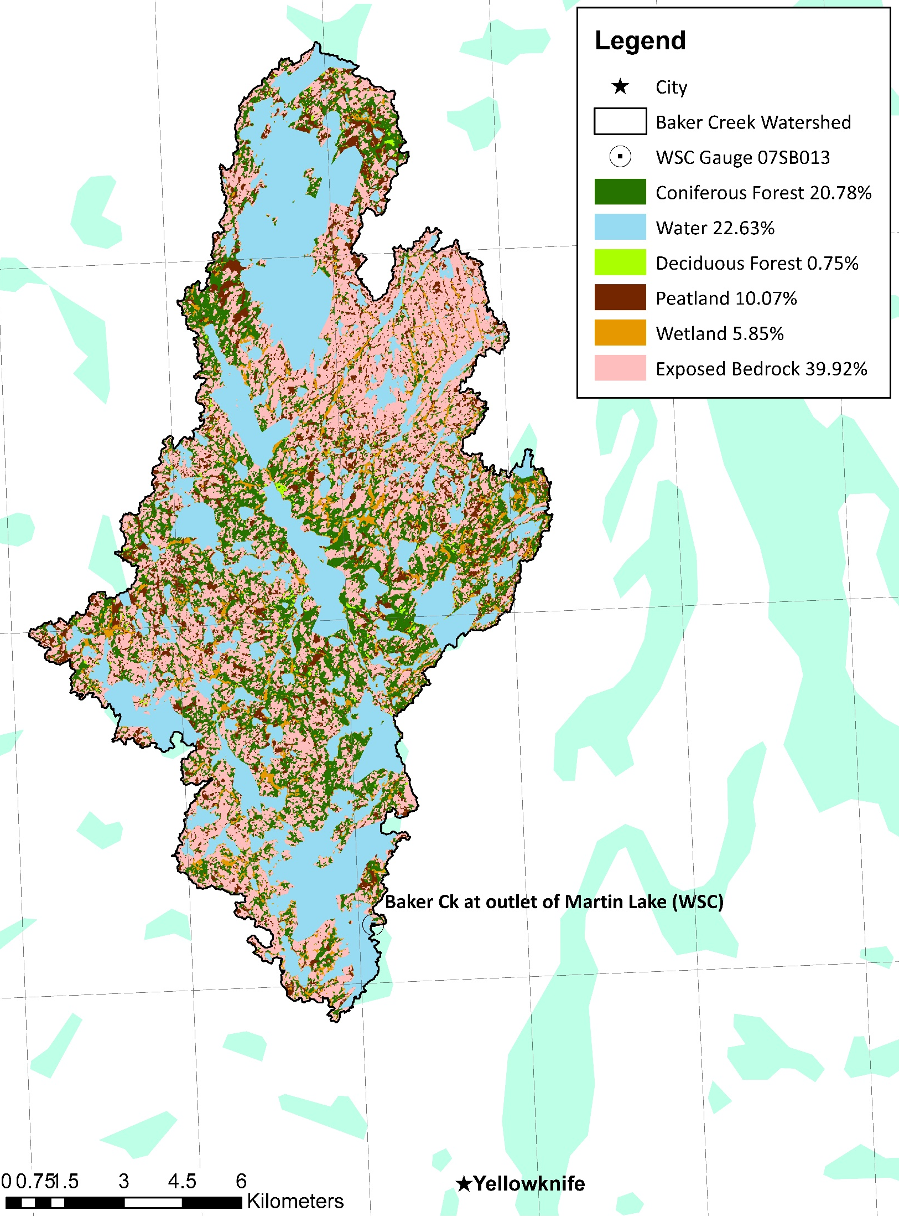
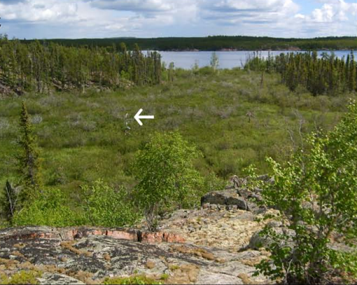
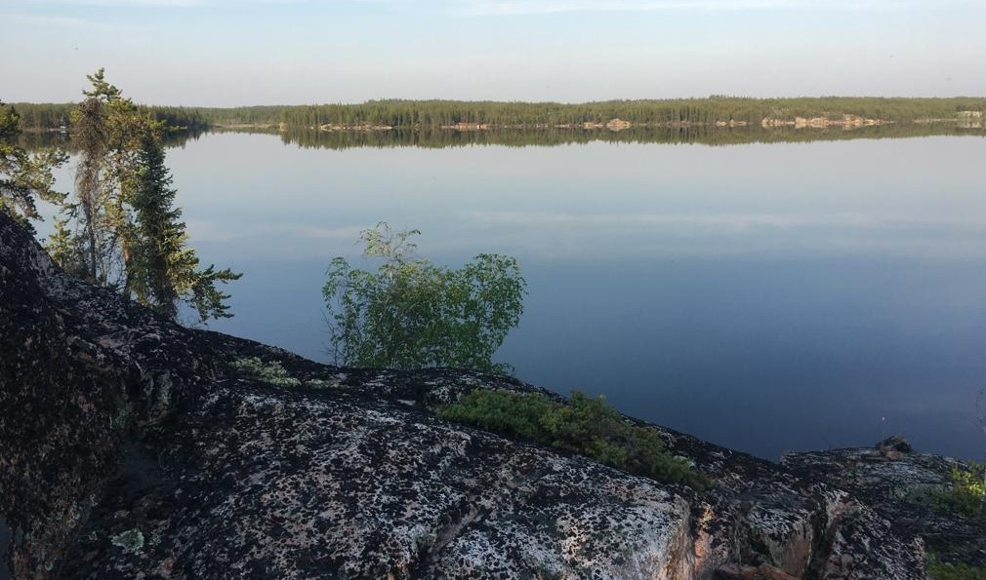
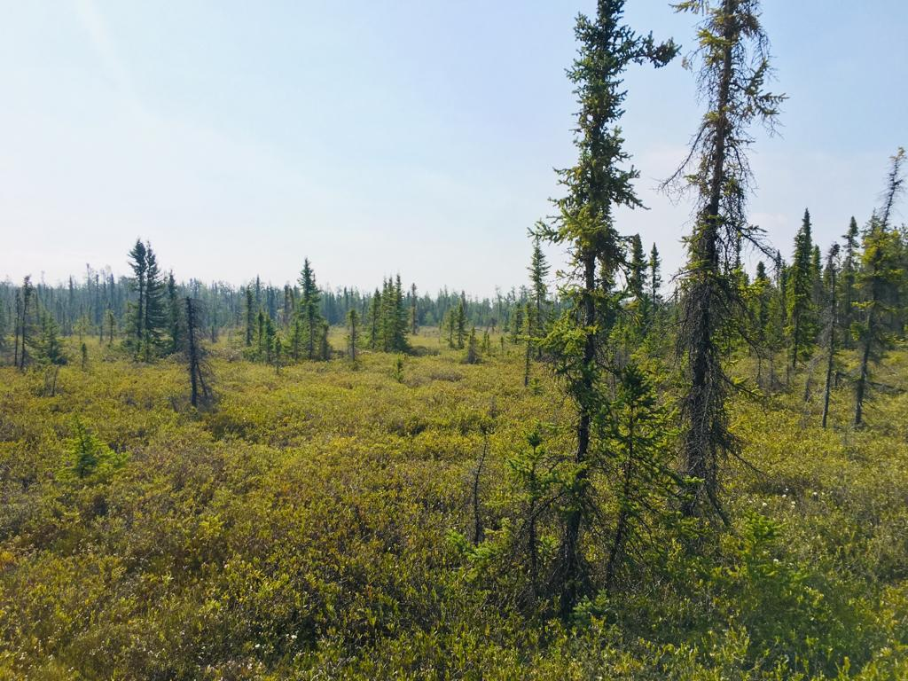
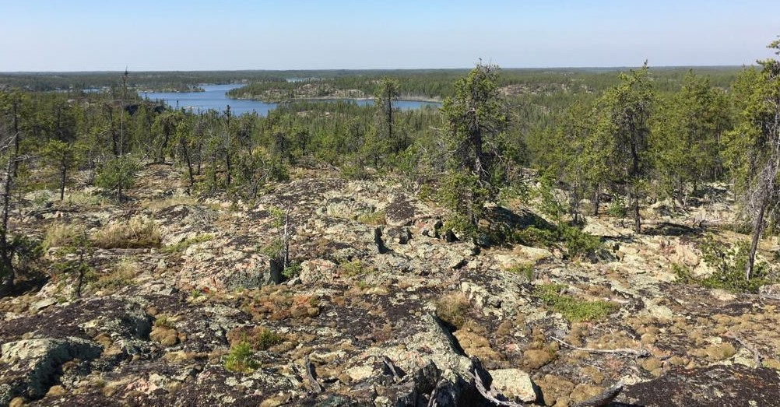
Site Familiarization
Vegetation and Landcover
Photo credit: A. Cook, 2019
Spence & Hedstrom, 2018; Cook, 2019; Guan, Spence, & Westbrook, 2019
Notes:
The main landcover types in the basin are shown here, and you can see bedrock in the foreground, short open forests, with a large lake and coniferous forested hillslopes in the background.
Again, bedrock, a lake, and forested hillslopes.
This is a wetland area, which flows into Vital Lake
This is an example of peatland, which are large peat-filled depressions with short shrub cover and some jack pines

Slide 11
Data Preparation

Slide 12
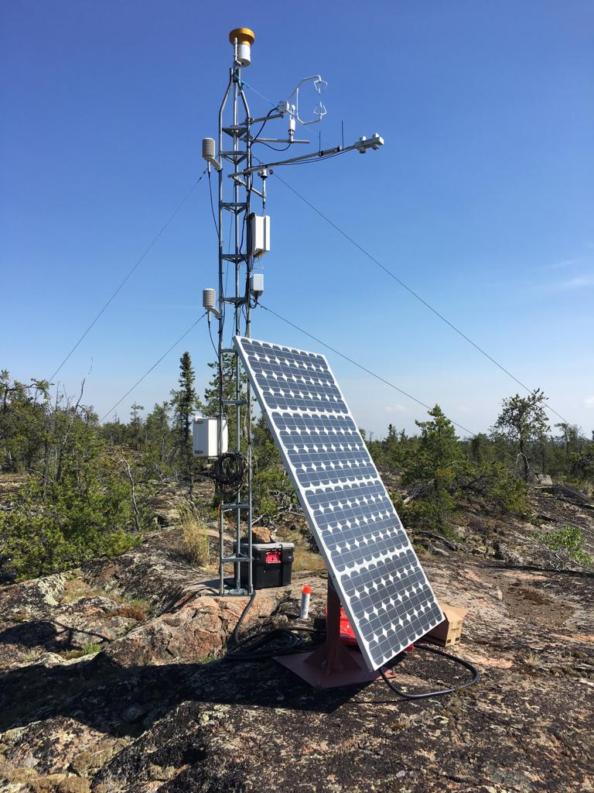
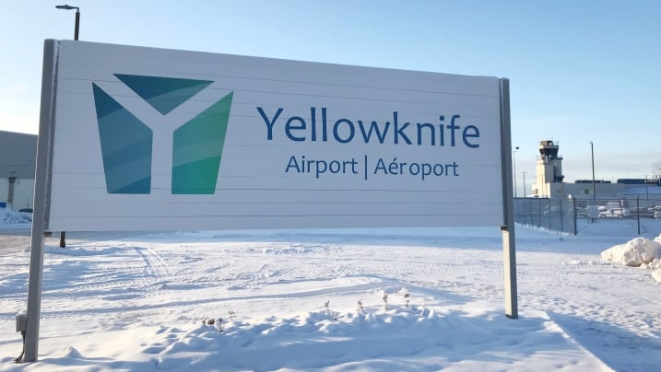
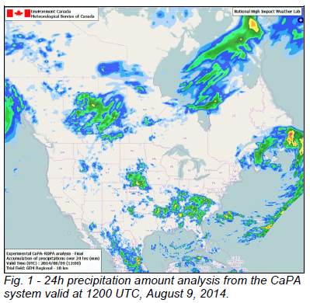
Data Preparation
Methods
Combine several different datasets
Unit conversions, timezone shifts, interpolation, measurement elevation shifts up to 40m,
1 continuous dataset
All using R
QA/QC
Graphical comparison
Conservation of mean or sum
Results
Continuous set of forcing data for the modelling period for 7 hydrometeorological variables
Vital Tower
https://www.cbc.ca/news/canada/north/yellowknife-airport-fees-take-toll-air-north-1.4482135
GEM and CaPA
Spence & Hedstrom, 2018; ECCC, 2014
Notes:
Data preparation was a significant chunk of my project. I combined data from three different sources – a research tower on site, Environment Canada station at Yellowknife, and the environment Canada climate model datasets.
I performed unit conversions, timezone shifts, interpolation, and measurement elevation shifts up to 40m – the reference height for the model.
All was done using R, and I also QA/QC’d the data
At the end, I had a continuous set of forcing data for the modelling period for 7 hydrometeorological variables.

Slide 13
Modelling

Slide 14
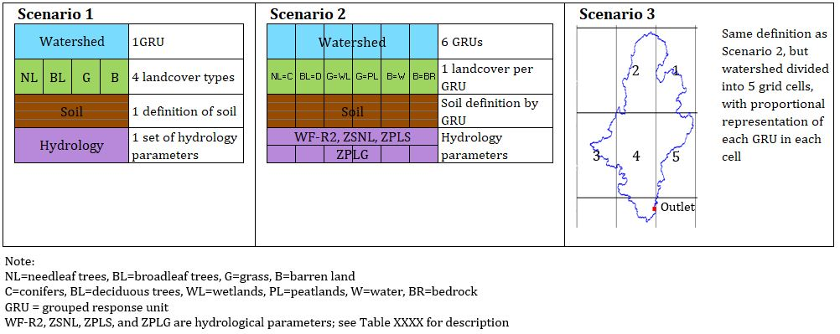
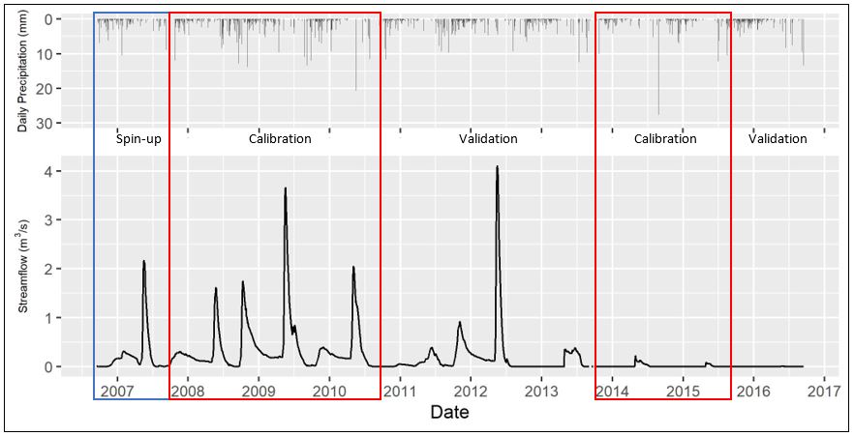
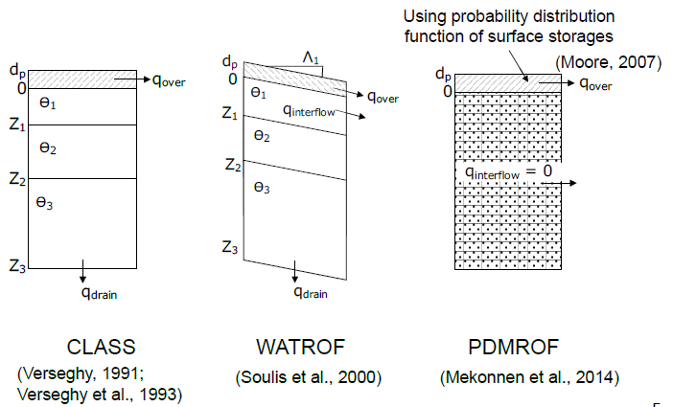
Modelling
Methods
3 Phases
Phase 1: replicate White Gull Creek methodology (S1 & S2)
Phase 2: Increase complexity by adding more grids (S3)
Phase 3: PDMROF (S1-P and S2-P)
Calibration and Validation
1 year spin-up: Fall 2006-2007
5 years calibration: Fall 2007-2010 & 2013-2015
4 years validation: Fall 2010-2013 & 2015-2016
Parameterization and initial conditions
From the literature – Baker Creek and other MESH modelling
First-hand knowledge of the watershed
Calibration
OSTRICH program
1000 iterations for 100 trials
Ran in batches to reduce total run time
Nash-Sutcliffe objective function
Lumped
Semi-distributed
Hossain et al., 2016; Spence & Hedstrom, 2018; Mkandla, 2017;
Notes:
Modelling was conducted in 3 phases. Phase 1 was a replication of the methodology used for modelling the White Gull Creek basin which included Scenario 1 and 2. The main difference is that Scenario 1 had 1 GRU and 2 had 6 GRUs. A GRU is a subset of the watershed that is expected to behave hydrologically similary. For phase 2 (scenario 3), I increased the complexity of the model by adding more grid cells, and in Phase 3 I repeated Scenarios 1 and 2 using a different runoff algorithm, PDMROF, which incorporates a variable contributing area (fill-and-spill)
I had a 1 year spin-up for the model, calibrated to two different periods (1 wet and 1 dry), and then validated the model against the remaining wet and dry years.
I parameterized the model using published literature about Baker Creek and MESH modelling in other areas, as well as by talking to Chris about the watershed.
Calibration was run using the Ostrich program with 1000 iterations per trial and 100 trials. Nash-Sutcliffe was used as the objective function.

Slide 15
Modelling
White Gull Creek Watershed
GRUs
Parameter Sets
Forcing Data
1
1
Uniform
1
2
3
4
5
6
Baker Creek Watershed
2
1
Distributed
Uniform
GRUs
Parameter Sets
Forcing Data
1
1
Uniform
6
6
Uniform
2
2
Distributed
Uniform
10 (5x2)
10
Distributed
Mkandla, 2017
Notes:
This is a quick comparison of the model configurations for White Gull Creek and Baker Creek. Due to only one ecodistrict and 1 set of driving data in Baker Creek (also, the watershed was about ¼ the size), I only had 2 scenarios instead of the 6 in the original study.

Slide 16
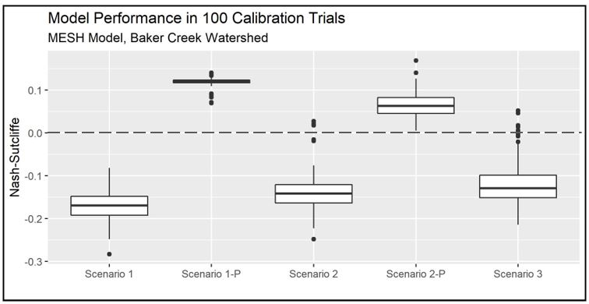

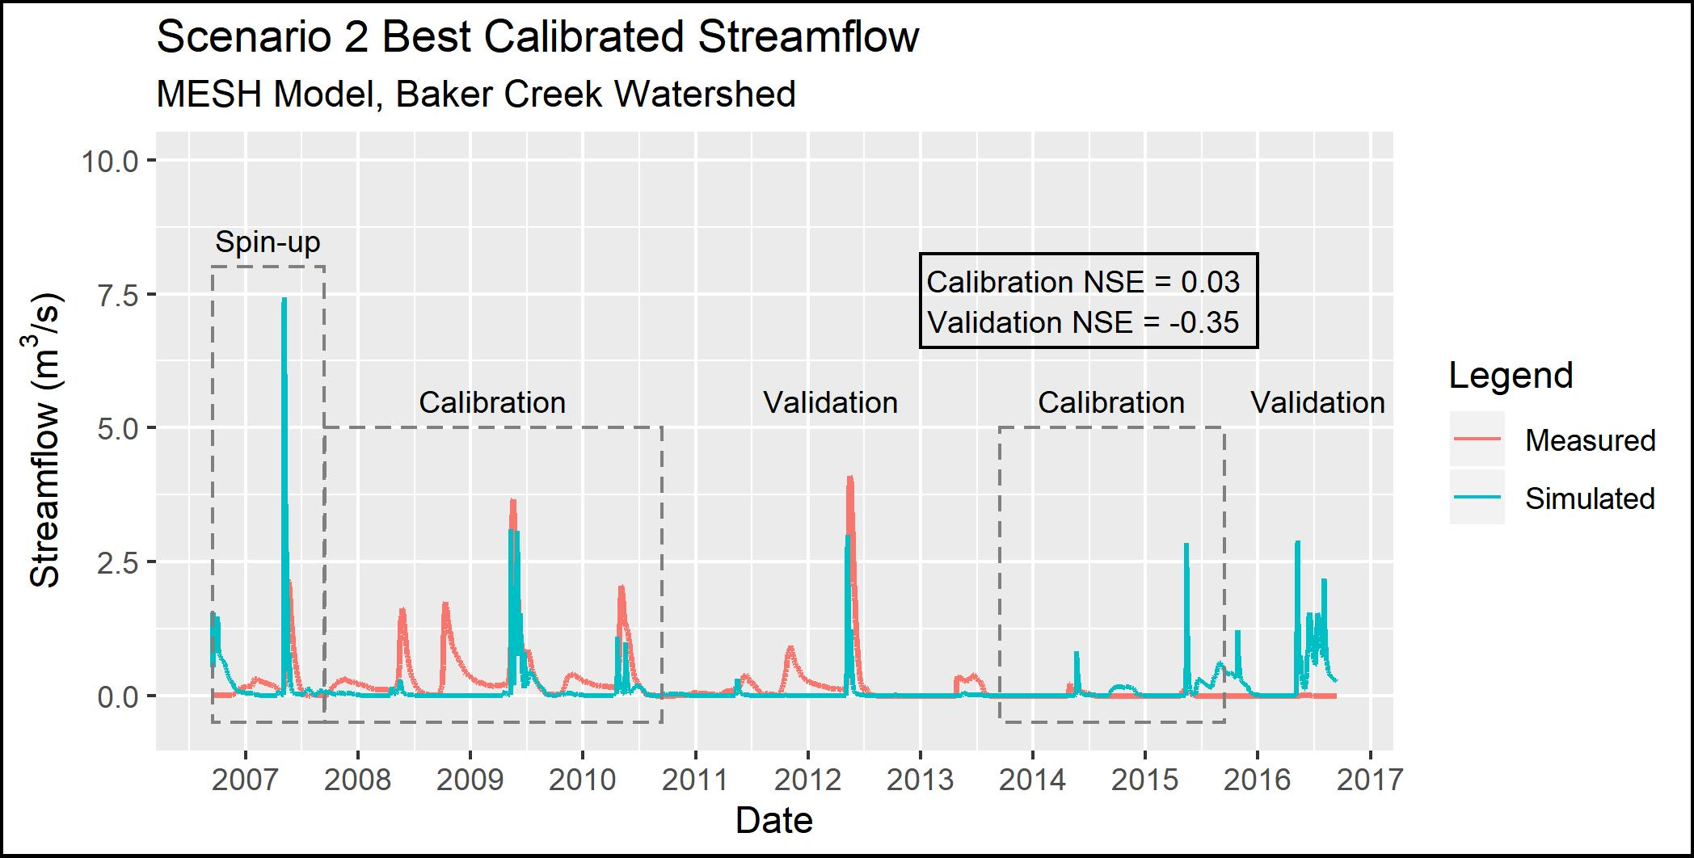
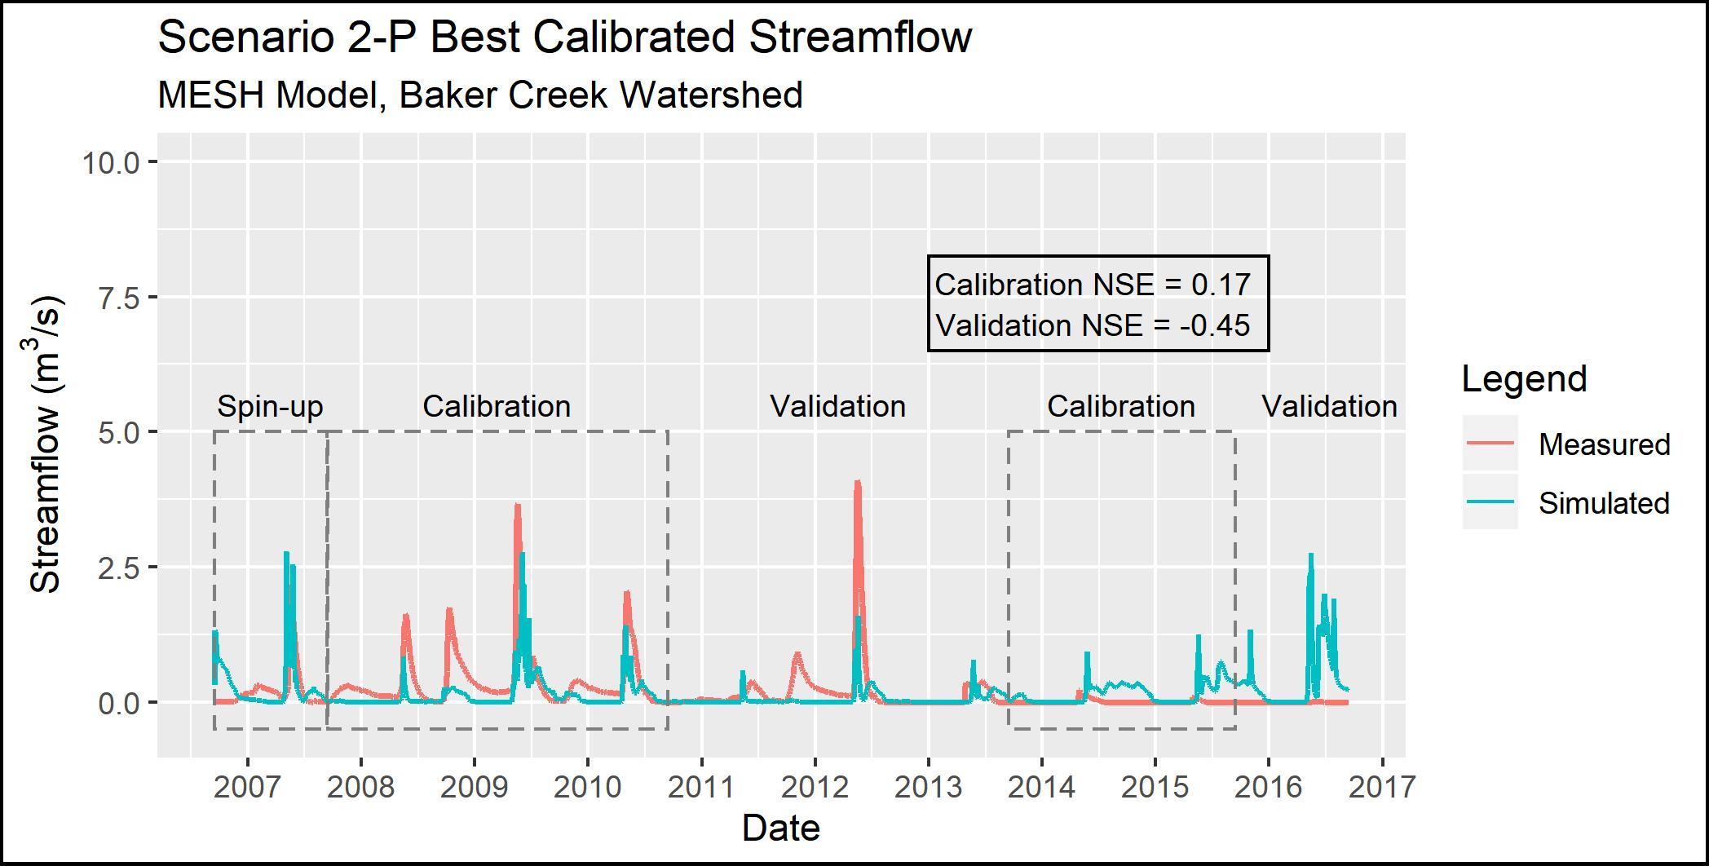
Modelling
Results
NSE =
Scenario 1 < Scenario 2 < Scenario 3
PDMROF performed better than WATROF
Streamflow
Most spring peaks modelled
Under-estimated in wet period, over-estimated in dry period
Fall peaks missed in S2, some shown in S2-P
Notes:
The first very obvious result was that the NSE values were very poor. However, there are still some meaningful trends. As the model complexity increased from scenario 1 through 3, so did the performance. Also, PDMROF performed better than WATROF in both cases. Looking at the comparison hydrographs, the spring peaks were captures, but they were underestimated in the wet period and over-estimated in the dry period. Fall peaks were missed in Scenarios 1 through three, but showed up in Scenario 2-P.

Slide 17
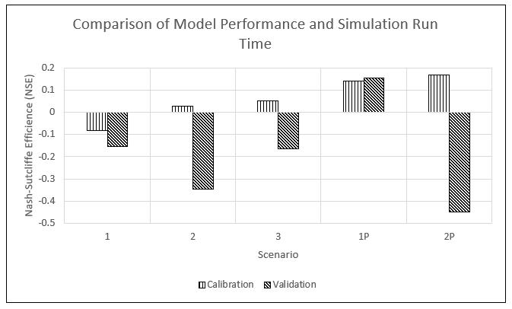
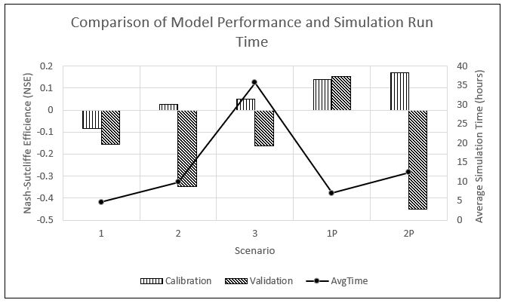
Modelling
Run time
Calibration vs Validation NSE
Mkandla, 2017
Notes:
I also found that the Run time increased with increasing complexity, with a significant difference between scenarios 2 and 3. A 262% increase in run time resulted in only marginal performance improvement.
Also, PDMROF took longer than WATROF
In every scenario except 1-P, the validation NSE was lower than calibration.
Increased with increasing complexity
25.8 hrs and 262% difference between scenarios 2 and 3
Marginal NSE increase from 2 to 3
PDMROF took longer than WATROF
49% longer (S1) and 26% (S1)
Cal vs Val NSE
Lower for all (<0 in fact) except Scenario 1-P
Identifiability:
Degree to which the “true” value can be obtained by the model
1 identifiable parameter in Scenario 1
3 in Scenarios 2 and 3
2 for Scenarios 1-P and 2-P

Slide 18
Summary of Findings Proposed Solutions

Slide 19

Summary of Findings, and Proposed Solutions
Peak flows underestimated during wet period and over-estimated during dry period
Calibration tried to match both, and did a poor job of both
Using NSE as the performance metric favored peak flows
Poor representation of bedrock
Model sends runoff directly to the stream, when in reality water is stored in fractures, wetlands/peatlands in the upland areas, in the large lakes before showing up as streamflow. Or, it is held in small depressions and evaporated/transpired
Recommendations:
Try calibrating to just during the wet period and/or during the dry period
Try using NSE of the log of the flows
Try calibrating to another measurement, such as ET and/or snow depth
Improve bedrock representation, either explicitly or effectively
Under-representation of fall peak flows
The model is not representing key hydrological process(es) that control elevated fall flows
PDMROF showed some higher fall flows (esp. 2009 and 2010) since it has a better representation of storage and release in the basin
Recommendations:
Improve the representation of the threshold functions of elements on the landscape (i.e. peatlands, wetlands, large lakes)
Try calibrating to the fall peaks

Slide 20
Summary of Findings, and Proposed Solutions
Very poor NSE results for all scenarios
Potentially an issue with 1 or more parameters or ranges
Could also be an issue with the initial soil moisture / temperature values, and/or thermal properties of the soil layer configuration
Recommendations:
Take another look at the parameters to try and identify where improvements could be made; perform a sensitivity analysis to assist with this
Initialize the soil moisture and temperature conditions with an iterative spin-up period
Change the layering and/or depth of the soil layers (Elshamy et al, 2019) since discontinuous permafrost location

Slide 21
Personal Reflection

Slide 22

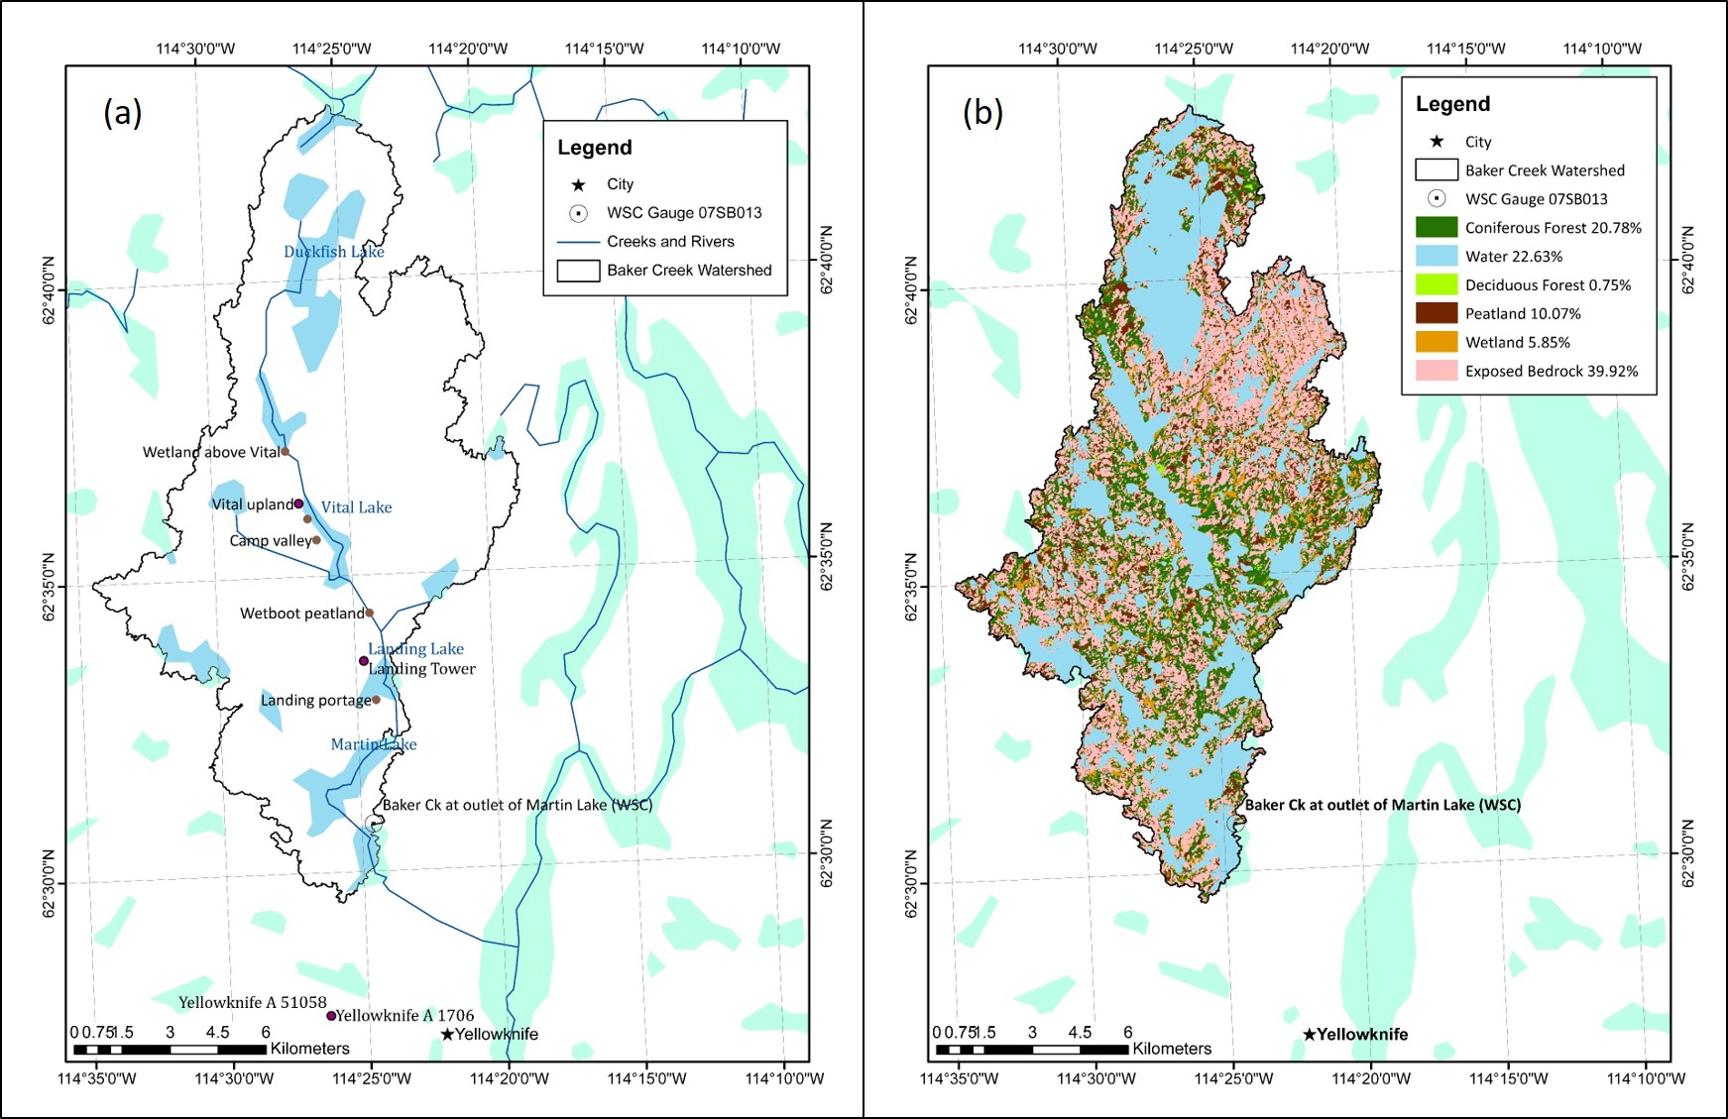
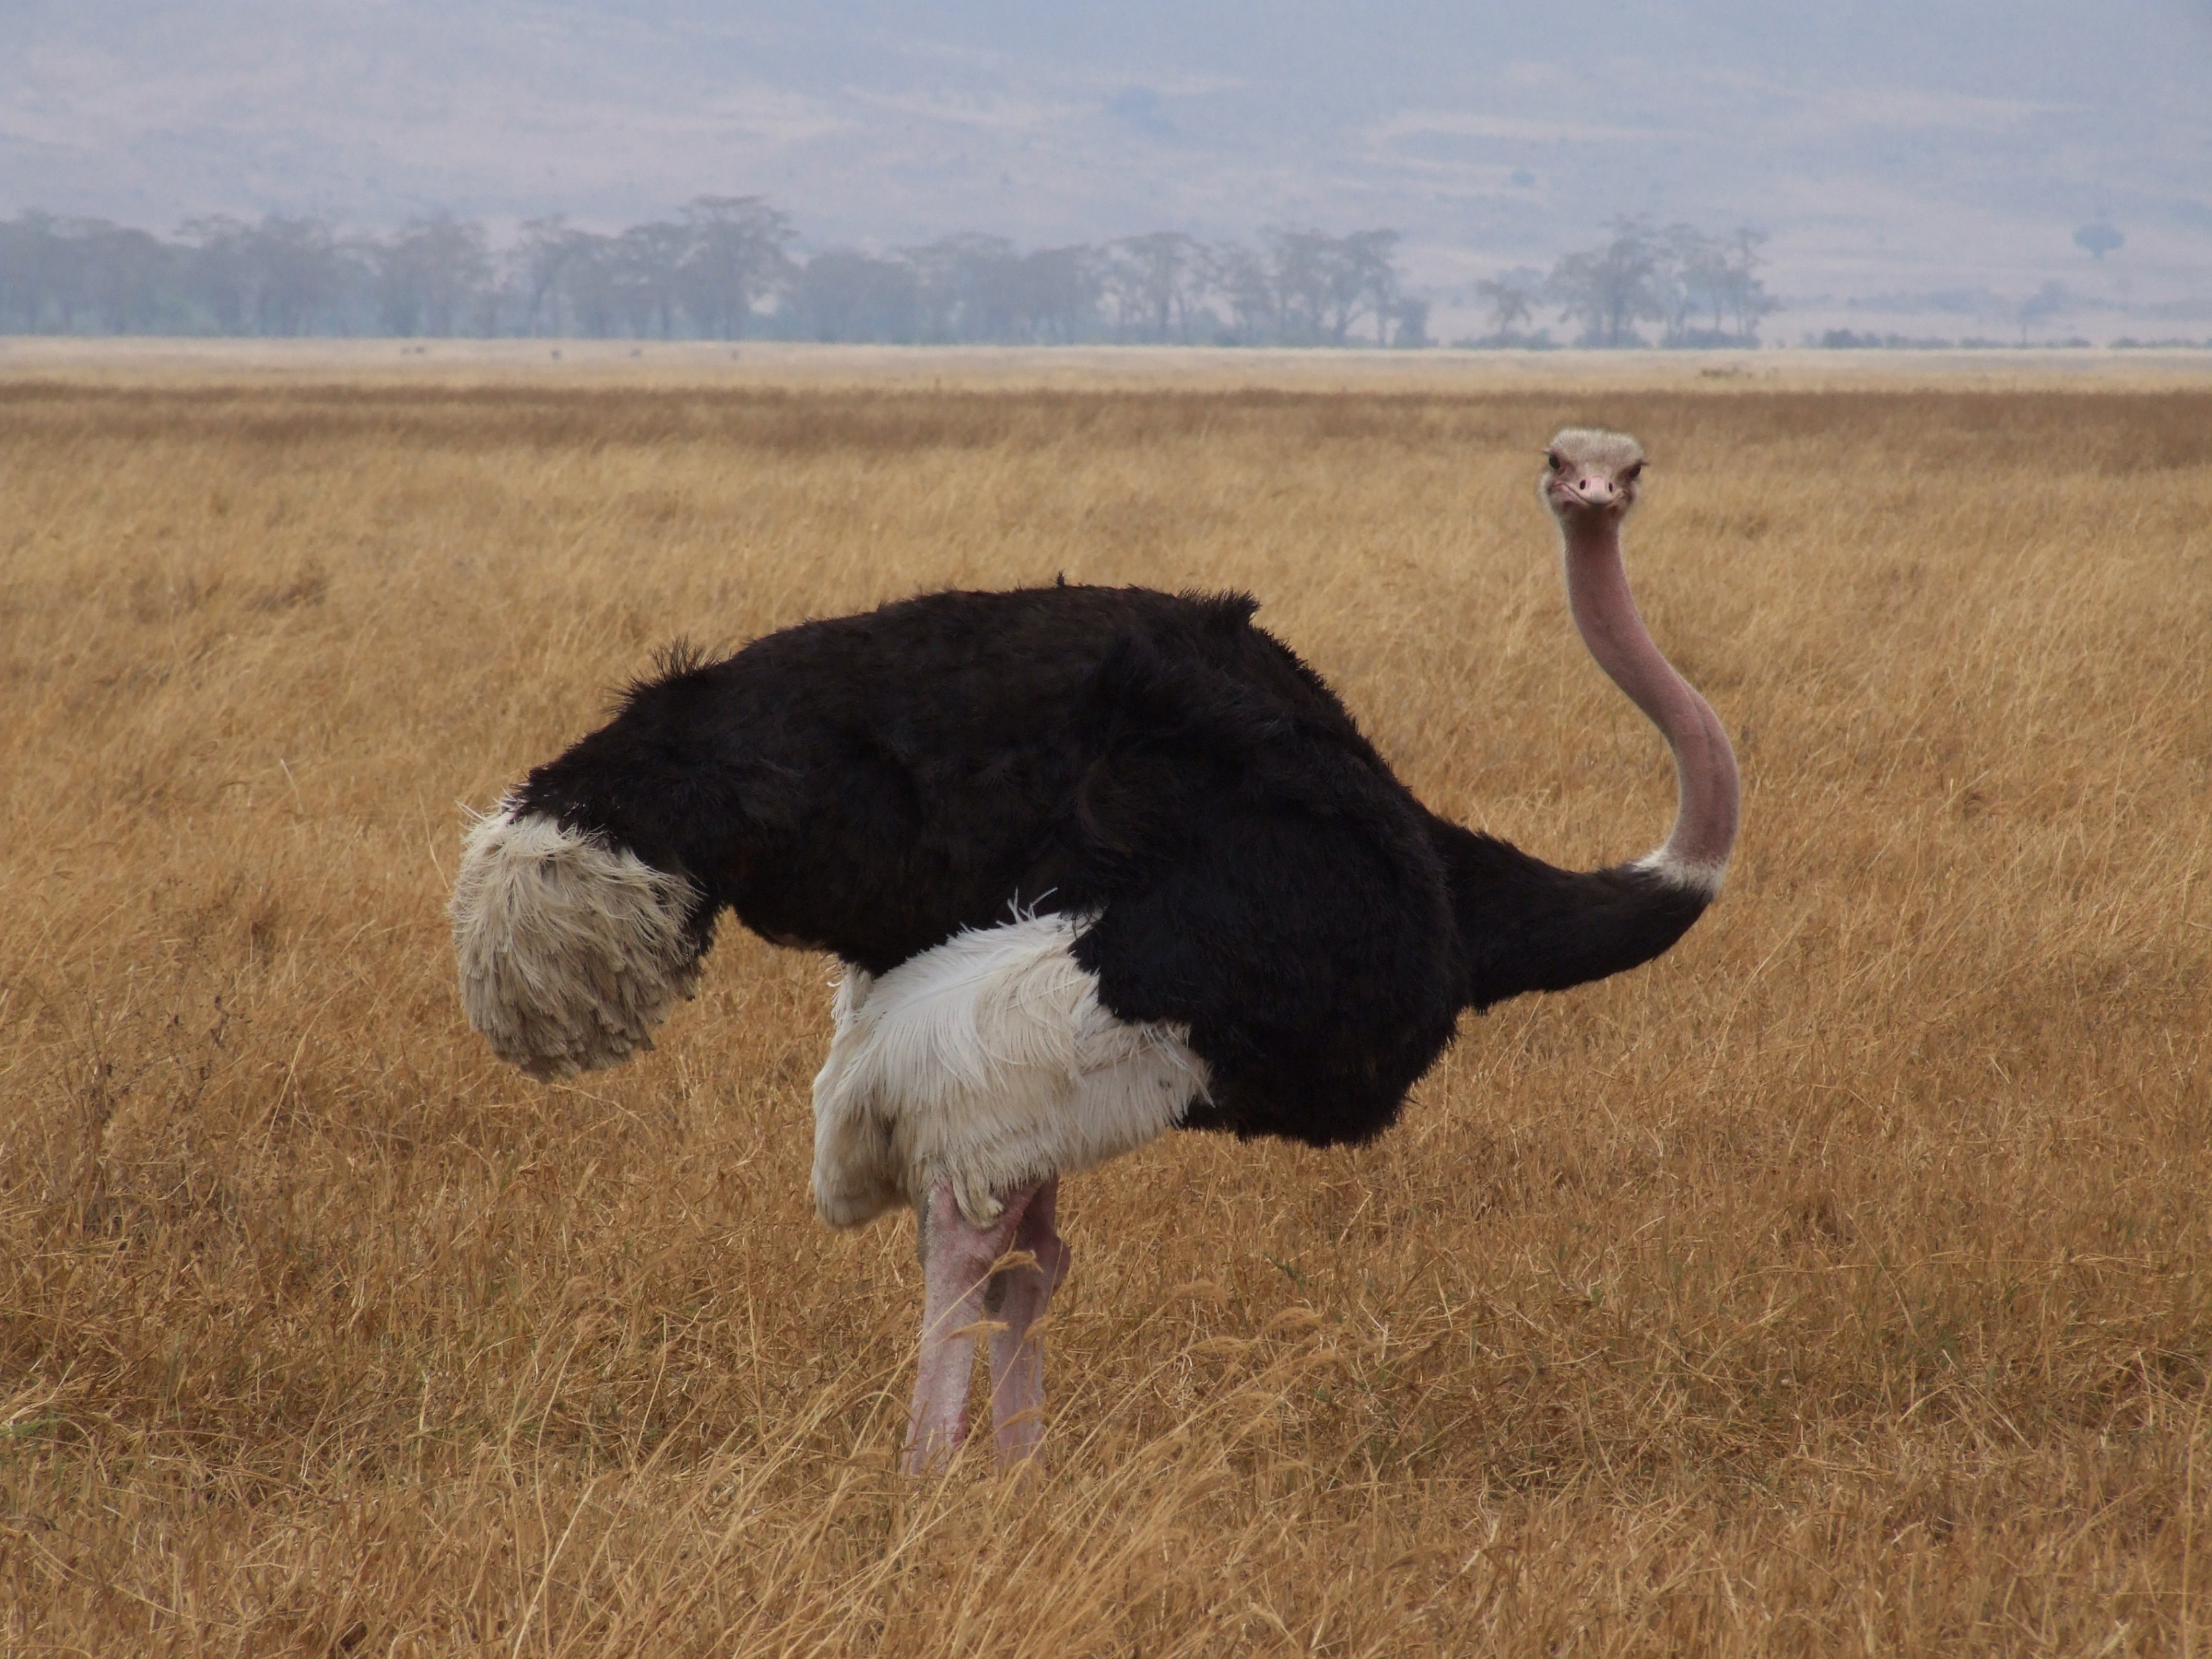




Personal Reflection
MESH
This Photo by Unknown Author is licensed under CC BY-SA
This Photo by Unknown Author is licensed under CC BY-NC
This Photo by Unknown Author is licensed under CC BY-SA
This Photo by Unknown Author is licensed under CC BY
This Photo by Unknown Author is licensed under CC BY-SA
Notes:
How long to struggle through things before asking for help
The importance of taking constructive breaks even when there is lots to do

Slide 23
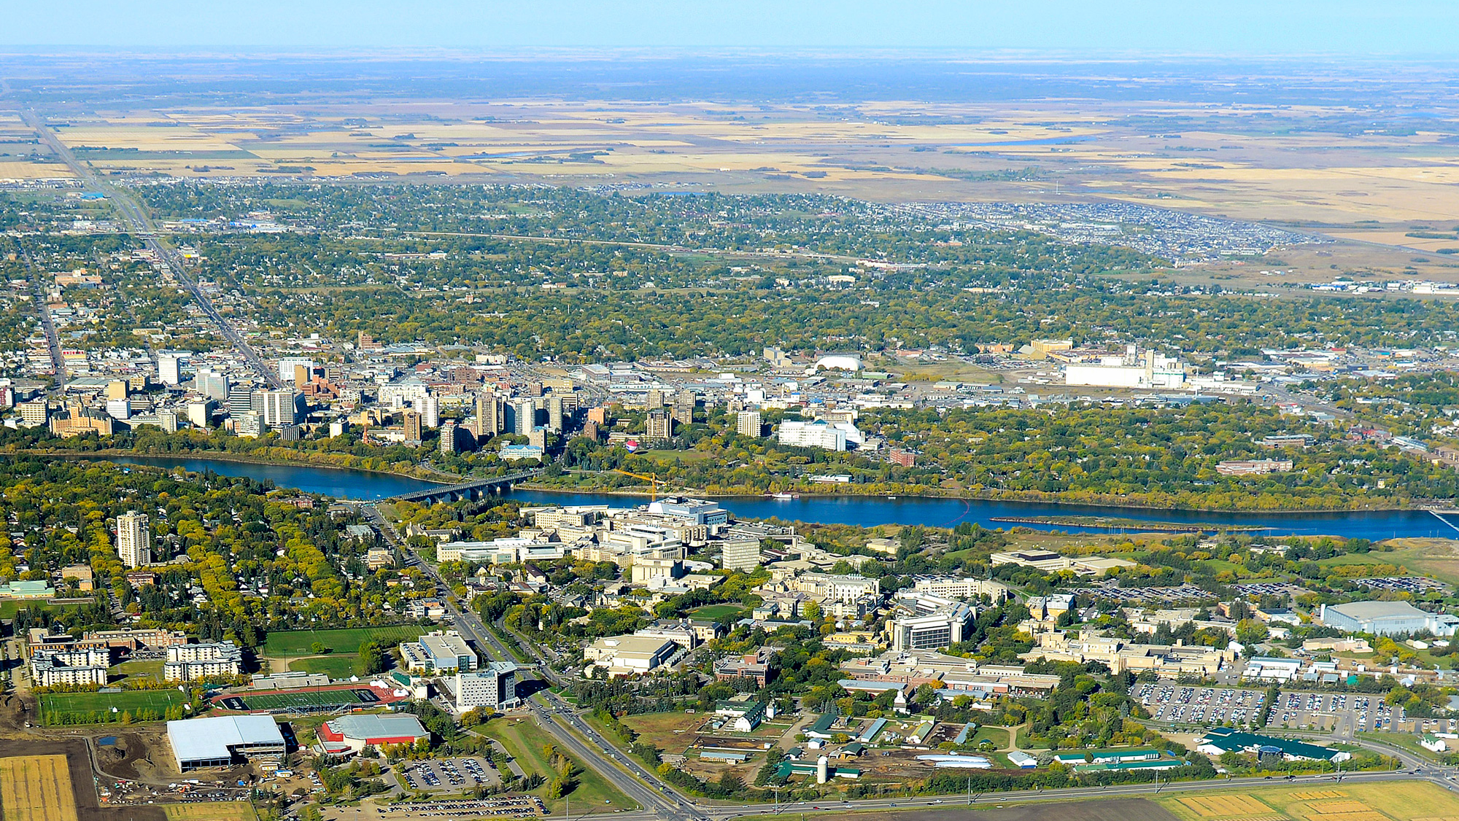
A great big THANKS! goes out to…
Bruce Davison and Environment and Climate Change Canada for putting forward this project and for guidance, direction, and encouragement along the way
Dan Princz (ECCC) for invaluable training and assistance in running the model, and overall MESH knowledge – I couldn’t have done it without you!
Chris Spence for imparting his first-hand knowledge of the basin
Andrew Ireson, for providing direction at the start of the project, training in Linux and R, and support during the project
Kevin Shook, for providing an R training session
Ines Sanchez, for assistance with using ArcMap
Amy Cook for the photos from the basin

Slide 24
Thank You!

Slide 25

References
Cook, A. (2019). Photographs in the Baker Creek Watershed. Northwest Territories, Canada.
Environment and Climate Change Canada. (2014, October 29). Regional Deterministic Precipitation Analysis (RDPA-CaPA). Retrieved from http://collaboration.cmc.ec.gc.ca/cmc/cmoi/product_guide/docs/lib/capa_information_leaflet_20141118_en.pdf
Guan, X. J., Spence, C., & Westbrook, C. J. (2010). Shallow soil moisture - Ground thaw interactions and controls - Part 2: Influences of water and energy fluxes. Hydrology and Earth System Sciences, 14(7), 1387–1400. https://doi.org/10.5194/hess-14-1387-2010
Haghnegahdar, A., Tolson, B. A., Craig, J. R., & Paya, K. T. (2015). Assessing the performance of a semi-distributed hydrological model under various watershed discretization schemes. Hydrological Processes, 29(18), 4018–4031. https://doi.org/10.1002/hyp.10550
Hossain, K, Elshorbagy, A., Bharath, R., Davison, B., & Wheater, H. S. (2016). A Comparative Study of the Runoff Generation Algorithms in MESH Hydrological Model, (May).
Mkandla, H. (2017). Representing Spatial Heterogeneity for the White Gull Creek Watershed using the MESH model. University of Saskatchewan, Global Institute for Water Security. Saskatoon: School of Environment and Sustainability.
Spence, C. (2006). Hydrological processes and streamflow in a lake dominated watercourse. Hydrological Processes, 20, 3665–3681. https://doi.org/10.1002/hyp
Spence, Christopher, & Hedstrom, N. (2018). Hydrometeorological data from Baker Creek Research Watershed, Northwest Territories, Canada. Earth System Science Data, 10(4), 1753–1767. https://doi.org/10.5194/essd-10-1753-2018
University of Saskatchewan. (2019a, August 7). About MESH. Retrieved from MESH - A Community Hydrology-Land Surface Model: https://wiki.usask.ca/display/MESH/About+MESH
Representation of Spatial Heterogeneity in the MESH Model

